Slide 1

Daria Solodey
Methodologist, course creator, English teacher

Slide 2
🔥
Our goal
Pass a job interview
Our rules:
Turn on your camera
Set up your microphone
Be active
Notes:
Если вам не хватило места, вы можете здесь написать развернутый комментарий.

Slide 3

Lesson Plan:
Discuss the differences between soft and hard skills
Learn what verbs are better to use in the resume
Study how to present your weaknesses and strengths
Notes:
Развернутый комментарий.

Slide 4
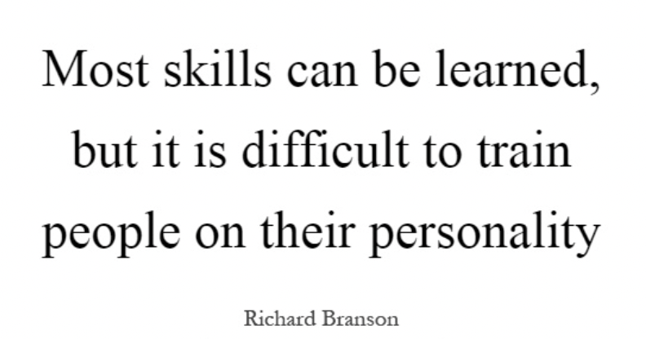
Do you agree with this quote? Why (not)?
I really feel that…
To my mind…
I guess/believe that…
Let me think…
To be honest...

Slide 5

What are skills?
What kinds of skills do you know?

Slide 6

There are 2 kinds of skills:
HARD & SOFT
What is the difference?

Slide 7
Match the type of skills and its definition. Give examples of soft/hard skills. Which skills are more important?
(people skills, social skills) abilities that can be applied in any job
are technical knowledge or training gained through any life experience in your career or education.
Hard skills
Soft skills
?

Slide 8
Match the type of skills and its definition. Give examples of soft/hard skills. Which skills are more important?
(people skills, social skills) abilities that can be applied in any job
are technical knowledge or training gained through any life experience in your career or education.
Hard skills
Soft skills

Slide 9
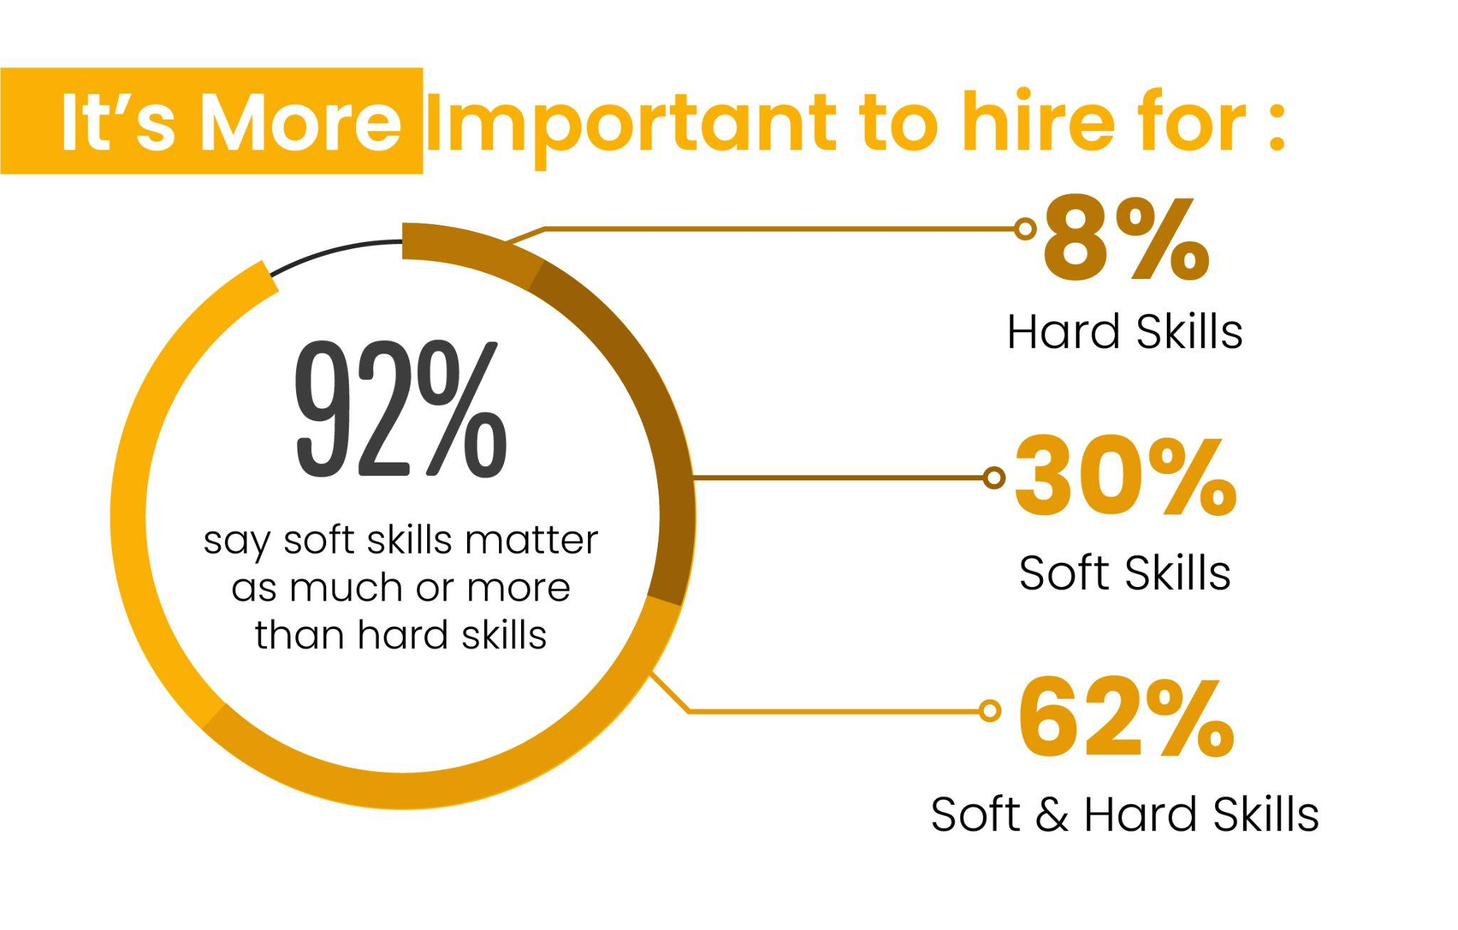
What do employers say about the importance of
SOFT & HARD skills?

Slide 10

Watch the video and answer the questions
What skills do employers want you to have?
Which examples of soft/hard skills do you remember from the video?
What do employers pay special attention to on your resume?
LET'S PRACTISE

Slide 11
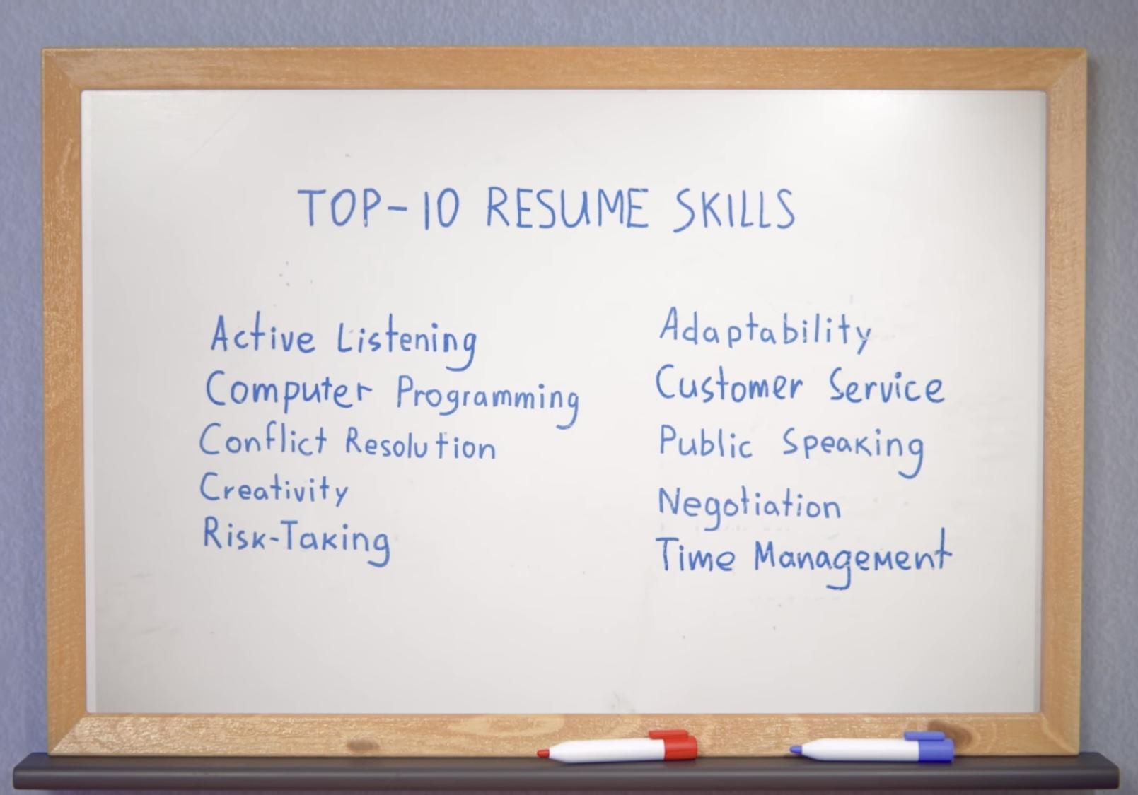
Have a look at the list of top 10 resume skills. Which of them are soft skills or hard skills?
Do you have any of the mentioned skills? Why may they be useful to your future employer?

Slide 12
What do these phrases mean? What are they called?
Can we use them in the resume?
The bottom line is…
To think outside the box
To move the needle
Thought leader
It’s all in my wheelhouse

Slide 13

Watch the first part of the video and answer the questions.
1. Сan we use the phrases from the previous slide in the resume?
2. What are no-no’s?

Slide 14
Let’s check the answers.
Сan we use the phrases from the previous slide in the resume?
No, we avoid them.
What are no-no’s?
No business lingo, no givens, nothing too general.

Slide 15
Watch the second part of the video and answer the questions.
1. What are strong action verbs?
(video)
2. Why do you need them instead?
(your opinion)

Slide 16
Let’s check the answers.
1. What are strong action verbs?
They speak to your value at your past jobs.
2. Why do you need them instead?
They show that you accomplished something at your past jobs, you weren't just “responsible for” it.

Slide 17
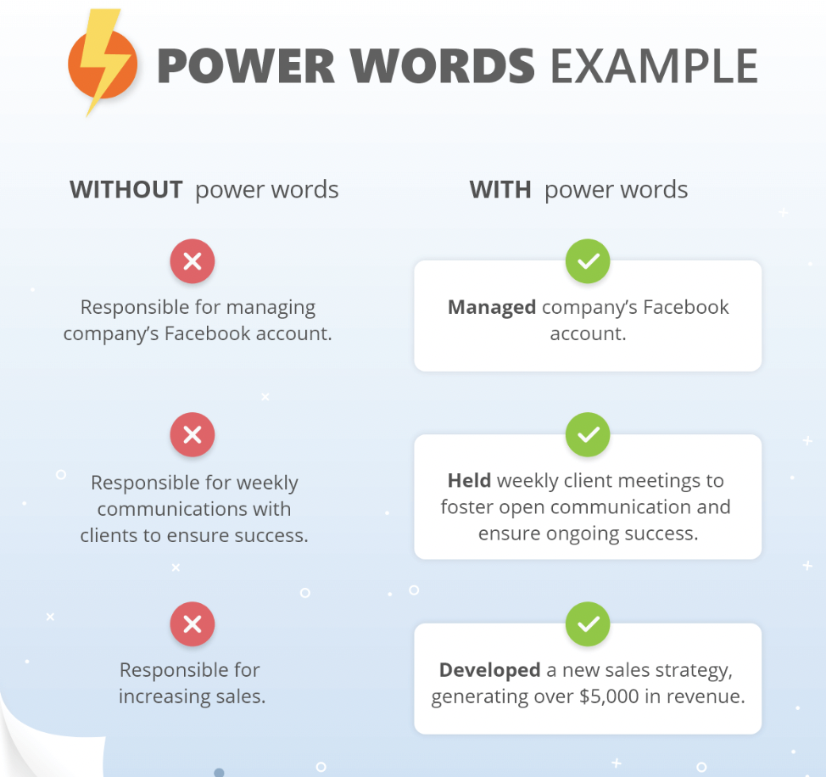
Take a look at the table.
Answer the questions.
How are strong action verbs different from other verbs?
Why should you use them in your CV instead?
Do strong action verbs make your CV more clear to a reader?

Slide 18

Distribute the strong action verbs
into four categories
Notes:
Active link 👆🏼👆🏼👆🏼 https://wordwall.net/resource/38340646/strong-action-verbs-for-cv

Slide 19
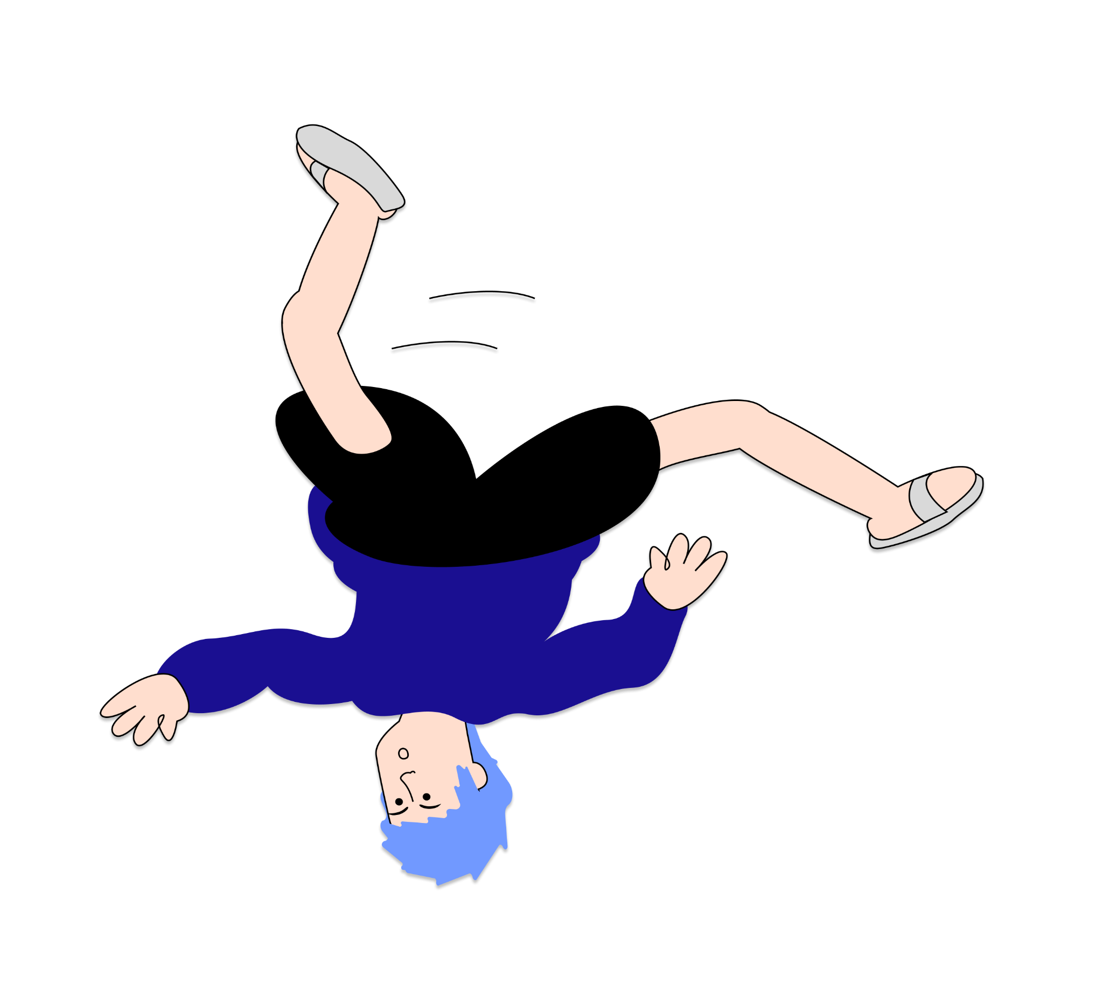
Let’s speak!

Slide 20

A person's strength was always his weakness, and vice versa.
What do you think your strength is?
Was it your weakness before? Are you afraid to lose this quality?
What do you think your weakness is?
Do you know somebody who was good at it?

Slide 21
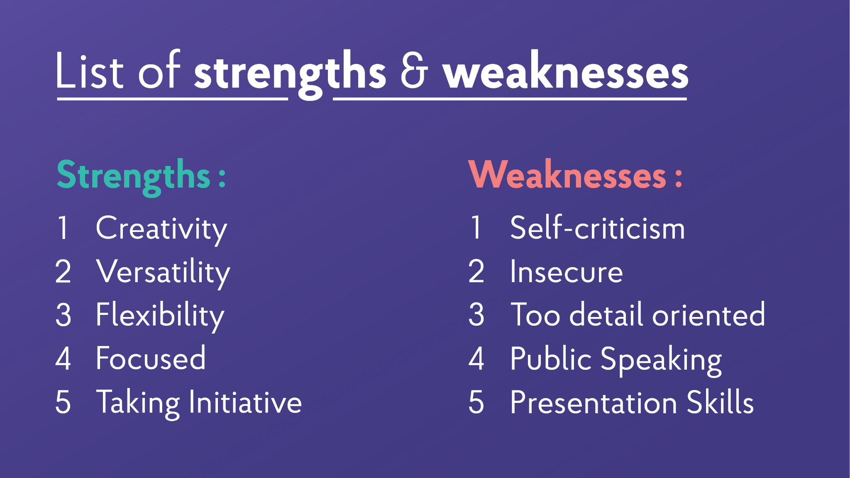
What are your strengths?
What are your weaknesses?
Let’s see some examples of the answers!

Slide 22
Weakness:
I think one area I could work on is my delegation skills. I spend more time than necessary by doing everything on my own that could easily be delegated to someone else. I have never missed a deadline but I realized that I can slow things down if I take all the tasks personally without delegating to others.
Strength:
I am a solutions-oriented person and a quick learner. In my role as an electrical engineer, I learned to perform well under pressure when designing equipment because our team would not be able to win a contract unless we produced the blueprints quickly, with as few resources as possible. In these circumstances, I am not afraid to ask questions to figure out the challenge. I do extensive research for every client, so I can be extra prepared.

Slide 23
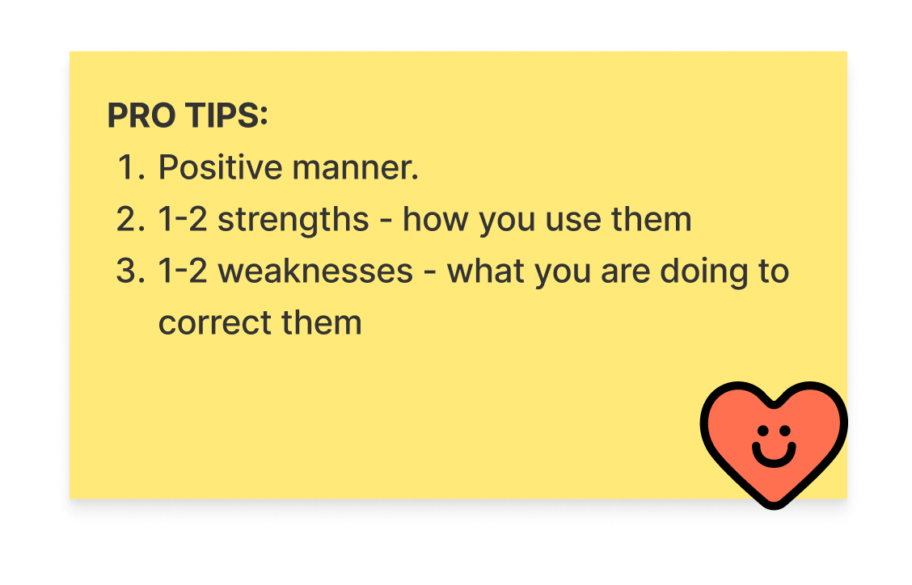
Answer the questions:
What are your strengths?
What are your weaknesses?
Weaknesses
1. I think one area I could work on is…
2. I realized that…
3. I am working on myself by…
Strengths 1. One of my strengths is that...
2. I’ve always been very good at…
3. It helps me…

Slide 24
Homework
Answer the interview question
What is your greatest weakness/strength?
(see pr. slides) and send to your teacher for proofreading
Learn the glossary for the next lesson
Revise the glossary and presentation for this lesson
Find out more about:
Hard Skills vs. Soft Skills: What Are They? (With Examples)

Slide 25

What can you do after this lesson?
I learned:
the differences between soft and hard skills
the verbs which are better to use in the resume
how to present your weaknesses and strengths
Notes:
Развернутый комментарий

Slide 26
Useful links:
Videos:
Top Resume Skills
Resume Words to Include and Avoid
The Intern | Full Movie Preview | Warner Bros. Entertainment

Slide 27
Thank you!

